Slide 1

Enterprise Asset Management
for Critical Assets subject to
Uncertain Demand
Norence Tan | Evan Heath | Ernesto Aguilar | Wilfredo Aleman
Notes:
EAM - This is the latest term SAP uses for Capital Asset Management / Plant Maintenance
Critical Assets are those whose unavailability would have major impacts to your business
Uncertain Demand the asset is used to produce goods, or deliver services and this demand itself is only predictable to a limited extent

Slide 2




The Team
Norence Tan
Evan Heath
Ernesto Aguilar
Wilfredo Aleman

Slide 3
Recap on the Challenges
Lack of Demand Data
Annual Estimates
Weekly Forecasts
Bad User Experience
Data Aggregation
Notes:
Intent was to look at five challenge areas related to the function of asset management in a customer’s SAP ERP implementation.
Quickly:
Lack of demand data, in form of aircraft flights, in SAP ERP;
Difficulty properly maintaining measurement point annual estimates for measurement points;
Inability to conduct weekly forecasting for resource requirements
Role of shift supervisors were provided a poor user experience
Elements of critical data (missions to be flown, aircraft available, maintenance required) could not be easily accessed at once, in one view.

Slide 4
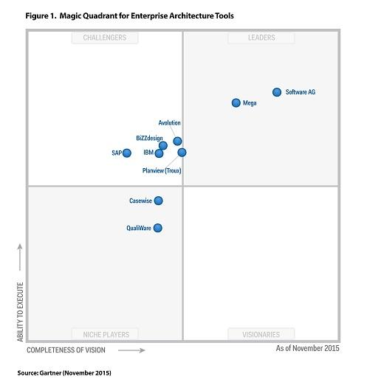





Enterprise Architecture Tools
… help enterprise architects and business stakeholders get a digital representation of their organization and its strategy, goals, business processes, and resources (Mega.com)
Notes:
To assist in modeling the current (as-is) and future (to-be) states of the organization at both the business and application levels, we needed to tool.
If you’re in the market for an Enterprise Architecture tool, here’s the Magic Quadrant.
Unfortunately, for our purposes these were all quite expensive and it wasn’t possible to get trial or student licensing for the period of this project.

Slide 5






Enterprise Architecture Tools
Archi (http://www.archimatetool.com/) was used:
Free and Open Source architecture modeling tool
Compliant with ArchiMate 2.1 (from Open Group)
Runs as a per-client install, but, plugin “Git Friendly Archi File Collection” exists to export a separate .xml file for each model entity enabling control of architecture with Git/GitHub
Capable of packaging architecture for export as HTML website
Notes:
So we used a free, open source alternative.\
Is per client install.
But you extend it with a plugin to support multi-user collaboration and content repository using git.
Capable of packaging architecture for export as HTML website for viewing by individuals who don’t have application.
We will generate a HTML export of the architecture for submission.

Slide 6
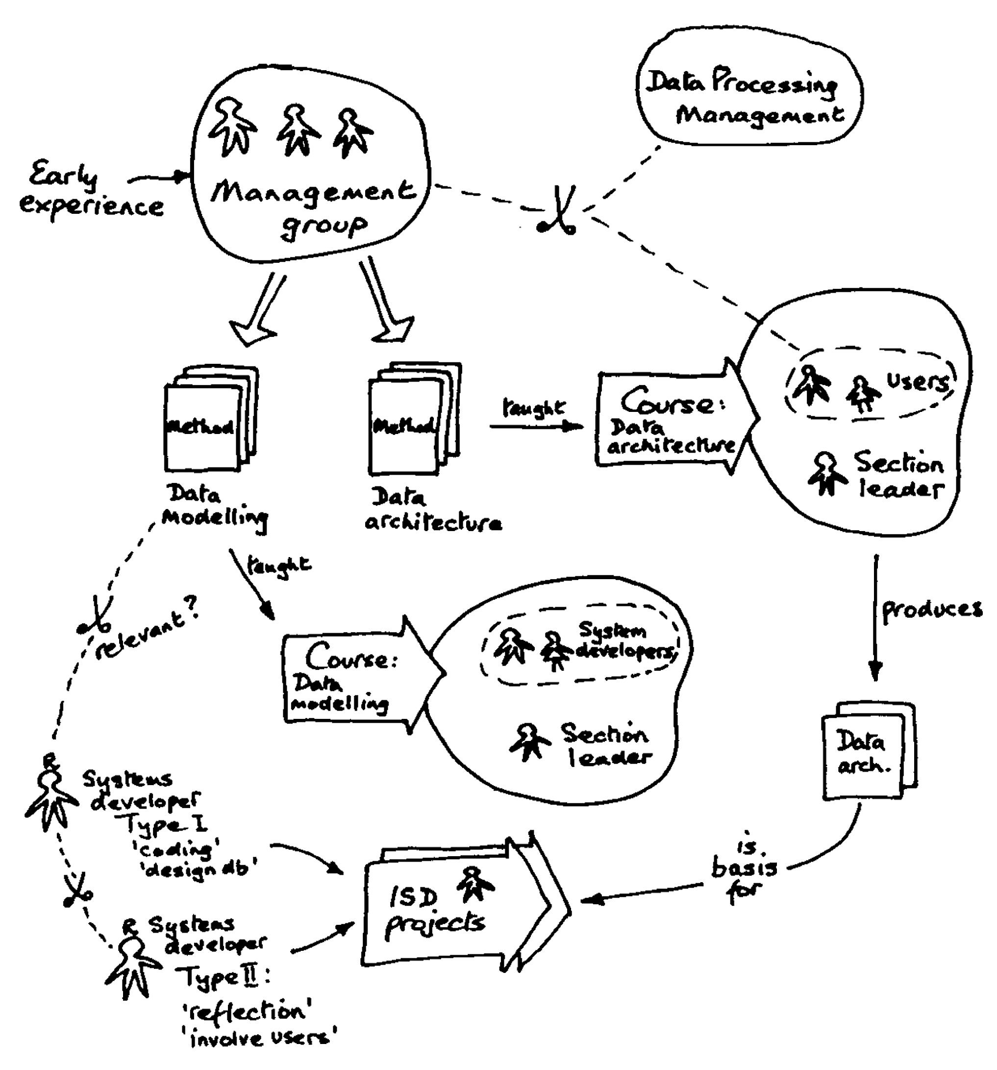
A Crash Course on ArchiMate
What is it? A framework for describing, analyzing and visualizing relationships amongst business domains
Within one framework, you can describe:
Why the business has needs/wants
How the business runs
Which technologies support the business, and how
And using Archi, you can eliminate the need for many, many MS Visio files.
Notes:
I’ll give a quick overview of what the models look like. I’m not presenting the content we’ve generated. It’s very specific to the problem and wouldn’t work well to explain the general concepts of the modeling language.
We used Three layers of the notation to identify the as-is and propose the to-be state.

Slide 7
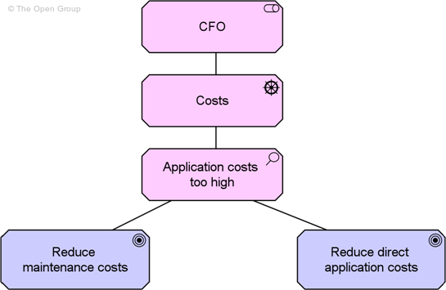
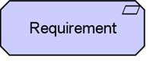
Archimate: Motivation Example ‘The Grumpy CFO’
Stakeholder
Driver
Assessment
Goal
Realization
Relationship
Notes:
“CFO” is a Stakeholder: the role of an individual, team, or organization (or classes thereof) that represents their interests in, or concerns relative to, the outcome of the architecture.
“Costs” are a Driver: something that creates, motivates, and fuels the change in an organization.
An Assessment was made that “Application Costs are Too High”: the outcome of some analysis of some driver.
“Goal”: an end state that a stakeholder intends to achieve.
… and you can create and associate requirements: a statement of need that must be realized by a system. To goals.

Slide 8
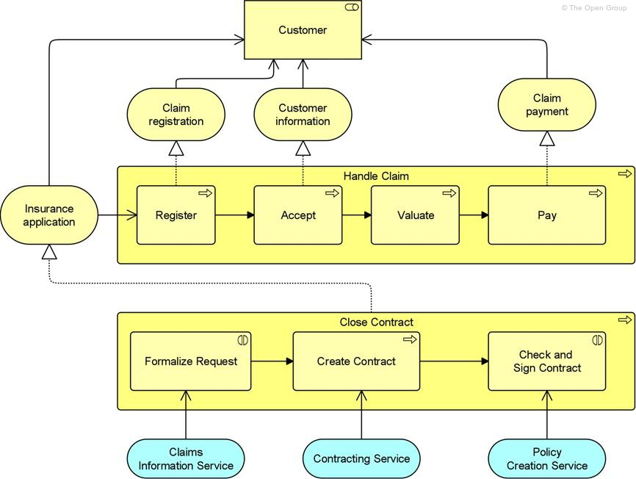
Archimate: Business Example ‘Crashed Car’
Business Role
Business Service
Business Process
Realization
Relationship
Business Interaction
Used by Relationship
Application Service
Notes:
Customer is a Business Role: as the responsibility for performing specific behavior, to which an actor can be assigned.
Claim registration is a Business Service: a service that fulfills a business need for a customer (could be internal customer or external… a customer customer).
“Register”... a claim is a Business Process: a behavior element that groups behavior based on an ordering of activities. It is intended to produce a defined set of products or business services.
Formalize Request is a Business Interaction: a behavior element that describes the behavior of a business collaboration (between customer and selling agent… but they’re not explicitly drawn))
Claims Information Service is an Application Service: a service that exposes automated behavior.

Slide 9
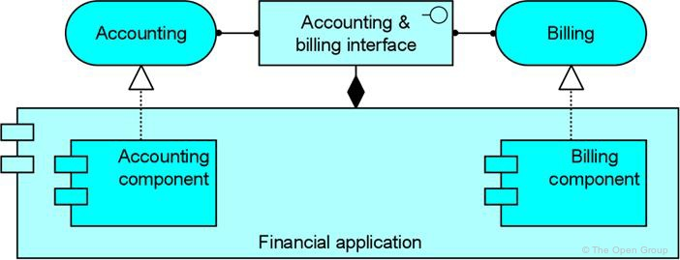
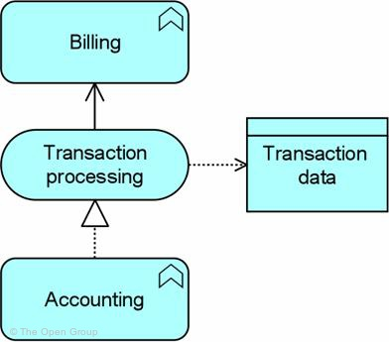
Archimate: Application Example ‘Bill for Stuff’
Application Service
Realization Relationship
Application Component
Composition Relationship
Application Function
Application Service
Data Service
Application Function
Notes:
The Accounting & Billing Interface is … an Application Interface: A point of access where an application service is made available to a user or another application component.
It is assigned both the Accounting and Billing services.
Accounting is an Application Service: A service that exposes automated behavior.
Is is Realized by:
Accounting component is an Application Component: A modular, deployable, and replaceable part of a software system that encapsulates its behavior and data and exposes these through a set of interfaces.
Both Accounting component and Billing component have a composition relationship with the Financial Application
Bottom Left:
Two Application Functions: A behavior element that groups automated behavior that can be performed by an application component.
Interact through an Application Service
Passing a data object: A passive element suitable for automated processing.

Slide 10







Challenge 1: Lack of Demand Data
Operations Planning
Maintenance
Exports
as-is
Reads
to-be
SAP Support for Flight Operations
Maintenance
Operations Planning
Notes:
In order to program the future work, the Maintenance department needs to know the future demand of aircraft. Right now, dynamically changing mission details are resident in a system accessible only to Operations Planners and delivered to Maintenance personnel periodically using static MS Office documents, which are used to plan aircraft type utilization and maintenance.
However, to supply aircrafts for flights, Maintenance personnel require up-to-date knowledge of demand data. Therefore, instead of using Excel files, our proposed solution is to configure native SAP ECC DFPS Support to Flight Operations ‘Flight Order’. Operations Planners will maintain relevant details of Missions within the Flight Orders which will be accessible to Maintenance personnel. Flight Orders can reference specific aircraft (Master Equipment) and link to Maintenance Orders for the maintenance required to prepare the aircraft for a flight.

Slide 11
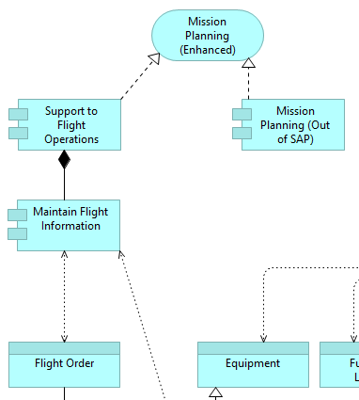
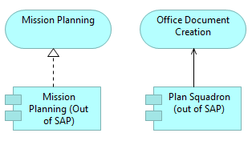
Challenge 1: Diagram
Current process: Mission planning out of SAP. Operations Planning creates and submits Excel files to Maintenance.
Proposed process: Excel files replaced by Flight Orders maintained in SAP
Notes:
Here we can see a partial view of our solution using ArchiMate. Basically, we are eliminating the “Office Document Creation” and adding a new application component (Support to Flight Operations) to support an enhanced Mission Planning service. What are some of the relevant details that will be available?

Slide 12
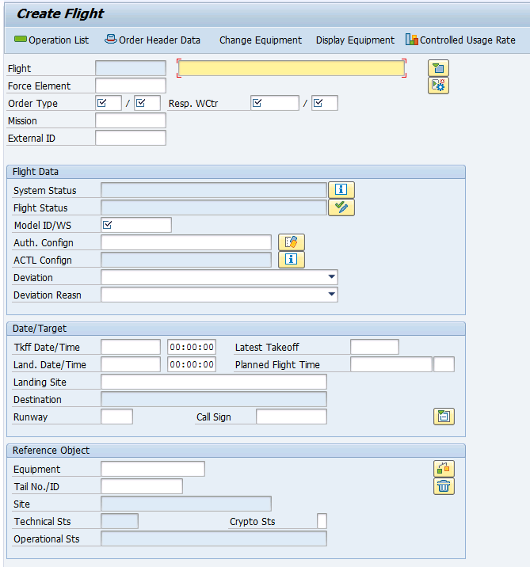
Challenge 1: SAP ‘Flight Order’
Notes:
For example, in the order header data main screen we can enter flight data (mission status and authorizations), date/target (scheduling requirements) and reference object (assigned equipment to accomplish this mission)

Slide 13
Challenge 2: Automated update of annual estimates
as-is
Task: Propeller Balance | Measuring Point: Flight Hours
Task performed every 200 flight hours, counter reset to 0 hours
Assumption: an aircraft flies 600 hours/year (annual estimate)
Actual values controlled in measuring documents
April
(Today)
August
(Scheduled)
What if someone entered the wrong annual estimate (e.g. 400 hours/year)?
April
(Today)
August
(Actual)
October (Scheduled)
So, accurate annual estimates are crucial in SAP Performance-Based Maintenance
Notes:
In performed-based maintenance, we monitor some variables or measuring points (flight hours) to decide the moment when we have to perform a specific task, such as Propeller Balance.
For example, we can say that we want to perform this task every 200 flight hours. If we assume that an aircraft flies 600 hours a year (that is called an annual estimate) then the result is that this task should be done approximately three times a year (the actual calculation made by SAP is in days, but anyway)
So if we are in April, this task would be scheduled for October.
However, if our annual estimate is wrong (let’s say we estimate 400 hours a year), then we will schedule this task too late. Because the actual flight hours will be higher, there will be a not very funny surprise waiting for the Maintenance Supervisor in October.

Slide 14
Technical structure of an aircraft for maintenance purposes
Aircraft 0001 [FLoc]
765473 Engine 1 Hours [MeasPt]
3004369 Aircraft 0001 [MasterEquip]
764583 Engine 1 Hours [MeasPt]
A001P Propulsion [FLoc]
A001PE1 Engine 1 [FLoc]
796581 Engine Hours [MeasPt]
A001PE1CT Controls [FLoc]
A001PE1CF FADEC [FLoc]
3008976 FADEC [Equip]
A001PE1C Compressor [FLoc]
806745 Engine Hours [MeasPt]
A001PE1CD1 Disk 1 [FLoc]
866342 Engine Hours [MeasPt]
3007896 Disk, Compressor [Equip]
752387 Engine Hours [MeasPt]
A001PE1CD2 Disk 2 [FLoc]
3007897 Disk, Compressor [Equip]
Measuring documents “flow” (are copied from parent to children) top-down, annual estimates do not.
Notes:
In SAP ECC, an aircraft is represented as a hierarchical structure of hundreds of Functional Locations and Equipment each of which may have many measurement points against which usage data is accrued. Maintenance Plans for Preventive Tasks reference annual estimates values of these measurement points in order to forecast due dates for preventive tasks. Thousands of separate measurement point annual estimates are not updated to reflect real-life utilization rates.

Slide 15
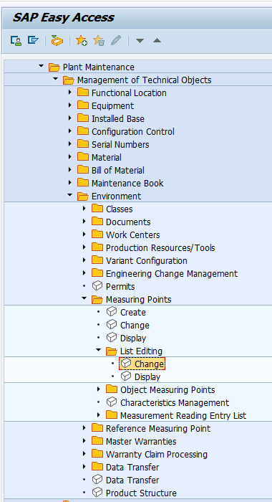
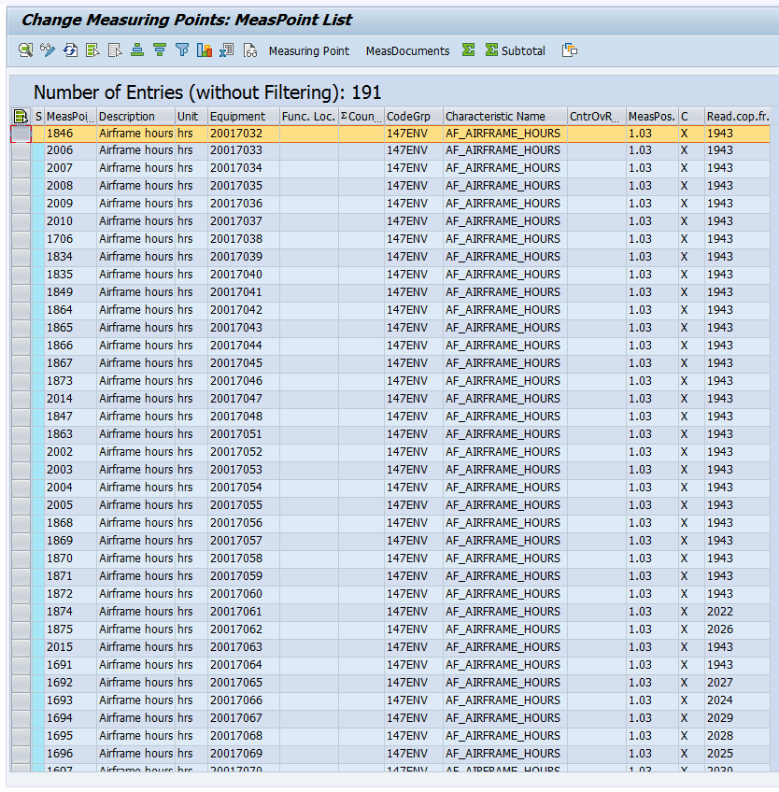
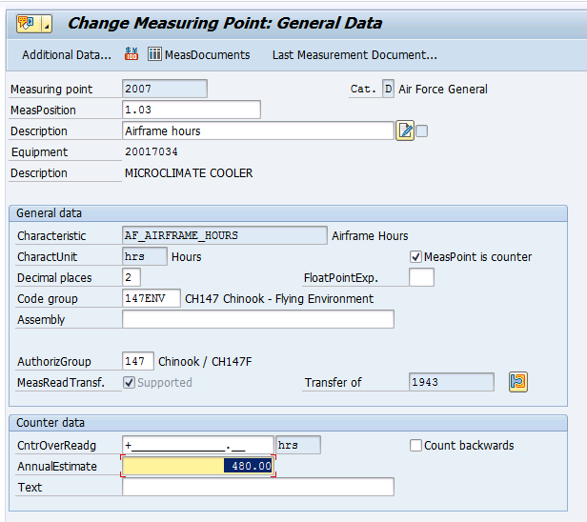
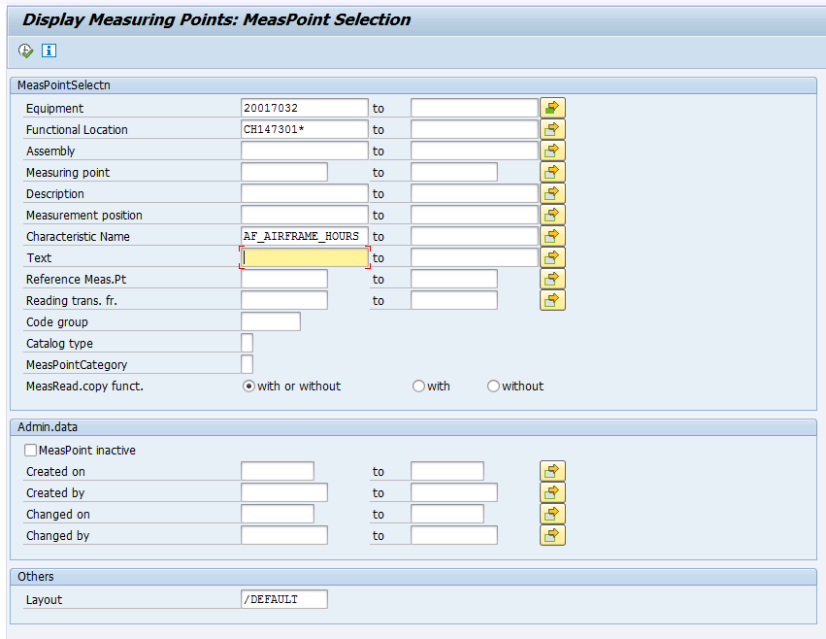
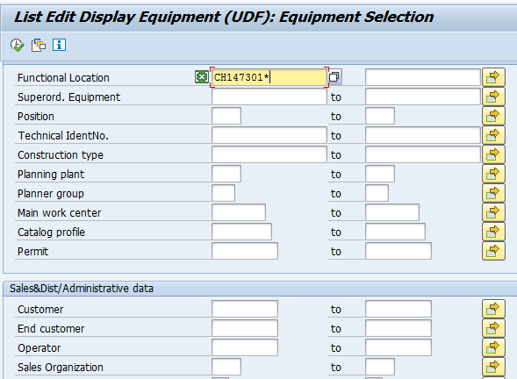
Challenge 2: How are annual estimates updated?
Notes:
How is this made nowadays?
Step 1: Find all the equipment installed in a particular aircraft’s Functional Location hierarchy. It will show produce a list of a few hundred equipments.
Step 2: List Edit to find all the individual measurement points for a particular ‘type’ of measurement (in this case, Airframe Hours) on any equipment or against any location on the aircraft.
Step 3: See there are 191 in the case of this Demo data (there would be more in Production… remember, for one aircraft!).
Step 4 (thru 195….): Update the Annual Estimate value individually for each measurement point and save.
As you can imagine, this activity is not high on anyone’s list of priorities!

Slide 16







Challenge 2: Automated update of annual estimates
to-be
1. Enter estimates for ranges of dates (custom tables + app)
2. Annual estimates recalculation, based on
Functional locations and equipment hierarchies
Measuring points and measuring documents
3. Annual Estimates Mass-Update (TABLE_IMPTT_UPDATE SAP)
Master Equipment Data
Notes:
Proposed solution
Custom transaction and tables to be developed to maintain aircraft specific usage rates per period at the master equipment level. Custom transactions to apply the correct usage rate to an entire aircraft’s technical structure hierarchy (all the subordinate Functional Locations and Equipment) en-mass calling the TABLE_IMPTT_UPDATE SAP function. To be developed.

Slide 17

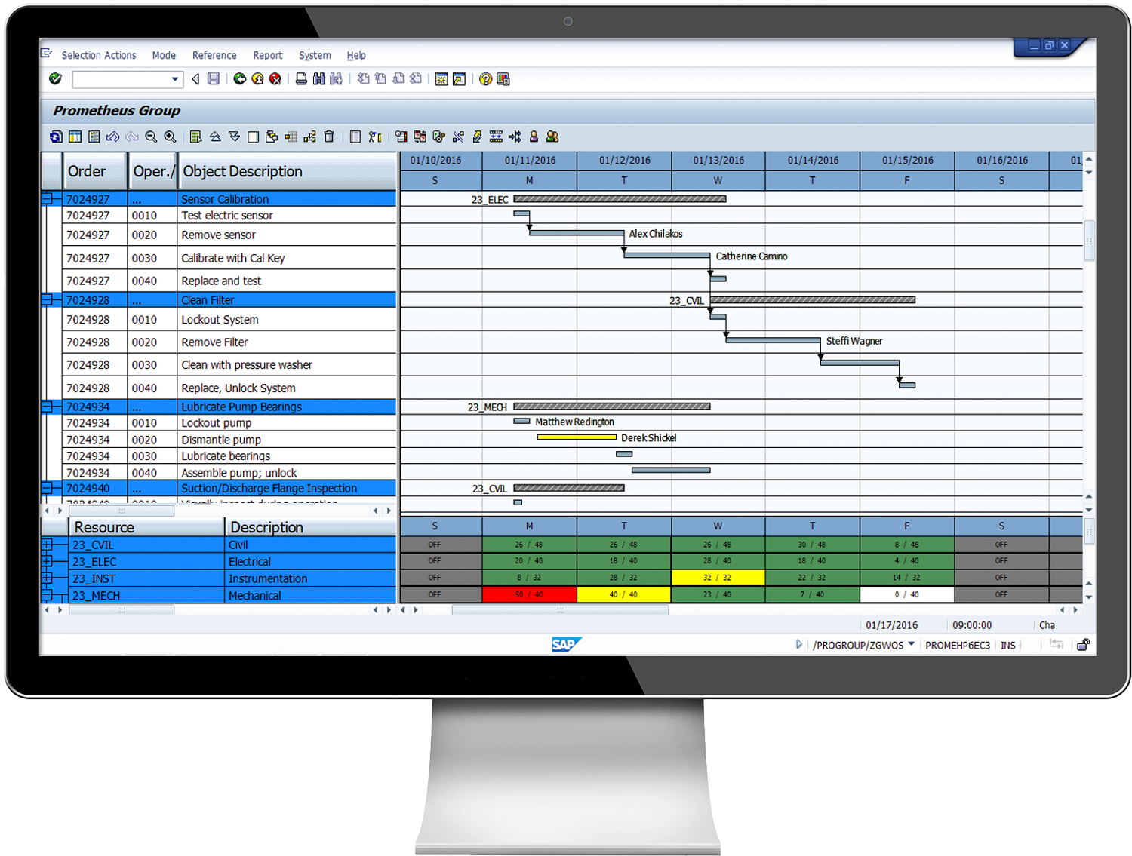

Challenge 3: Inability to Perform Weekly Forecasts
as-is
Maintenance Planners & Shift Supervisors
SAP solution for capacity requirements planning is available but not being used
Gap Identified: Standard SAP ERP does not provide usable interfaces for planning involving large volumes of requirements with many specific individual capacities.
Notes:
As-Is: - Maintenance Planners and Shift Supervisors collaborate using MS Office documents and information on whiteboards in order to match maintenance labour demand and supply. Standard ERP capacity planning is available but is cumbersome. Gap Identified: Standard SAP ECC does not provide usable interfaces when planning involves large volumes of requirements (maintenance order operations) with many specific individual capacities (specially skilled technicians or particular tools, support equipment, or facilities). ---------- Limited or no support on selecting critical business processes. Control maintenance is most neglected. Work orders are subjected to limited infrastructure, supply chain schedule and workforce limitations. Currently, shift supervisors determine which work orders are best to be executed right away, as facilitated by clipboards, whiteboards and spreadsheets. Schedule preventive maintenance has limited ERP support. Assets have determined thresholds of usage before a preventive maintenance is filed but due to corrective maintenance factor, scheduling becomes more complex and that ERP has limited functionality to aid shift supervisors. Work package date and state changes are not recorded in the course of the ERP processes. Moreover, technicians only document the work done in the ERP after the work order is completed. These two factors impact forecasting as there is no up-to-date information on work packages. ERP is used to create orders for Preventive Maintenance work but the dates are not set to optimal times because no one is maintaining information about what capacities are available to do maintenance at those times Current system implementation does not facilitate a process approach to controlling and executing maintenance. No workflow exists (both at the business and technical level) to move maintenance orders from early planning stages through to completion. Data (orders, operations) isn’t suitably configured to capture state changes during execution of business processes.
-------
SAP ECC (ERP Central Component)
http://www.prometheusgroup.com/erp/

Slide 18
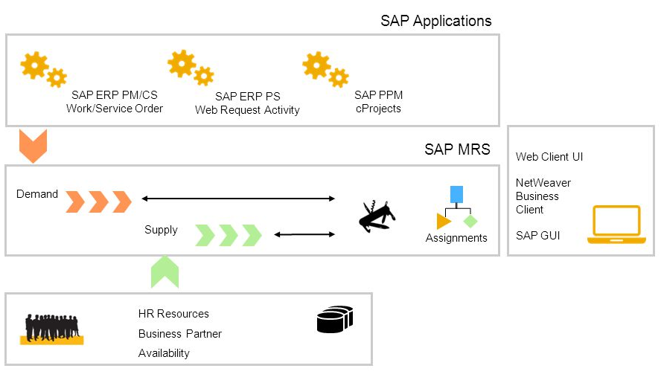
Proposed Solution: SAP Multiresource Scheduling
to-be
Notes:
Provide a ‘Scheduler Workplace’ within which the Maintenance Planner can work to balance the maintenance demands with supply of required resources such as labour, tools, support equipment, or facilities. (MRS) is a solution for resource management in Asset Management, it can be used across the whole range of demands (including Projects, Customer Service, Maintenance), allowing planners to visualize maintenance demand status and assign requests to the maintenance staff and tools using a graphical planning board. Helps in getting visibility into resource availability, maintenance status and data, to provide efficient collaboration across the planning process, minimize manual data input and errors, and provide accurate estimates and forecasts resulting in an optimized use of resources.
http://go.sap.com/product/plm/multiresource-scheduling.html

Slide 19
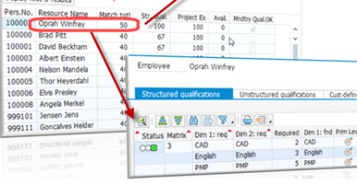
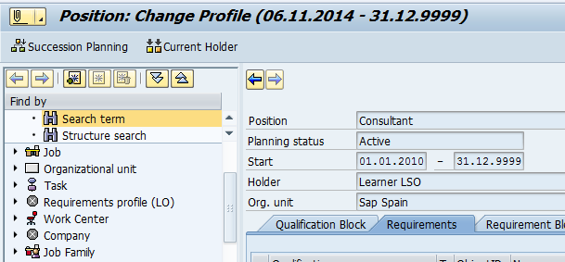
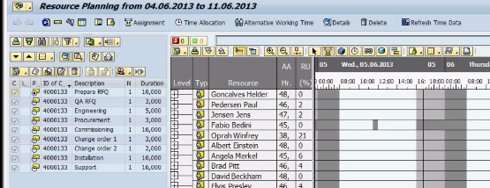
Overview: SAP Multiresource Scheduling
Demands
Qualifications
Multi Dimensional qualification
Resources
PS Network
Availability (HR)
Equipment
Qualification Profile
CS Order
MRS
- Graphical Planning Board
- Employee Search
- Qualification Matching
Notes:
Graphical interfaces to plan resources and demands
Automatic support for resource planning based on availability
Optimization of daily assignment planning
Track the status of assignments
When you are dealing with MRS the demands are directly the orders and operations itself, goes through the actual data and based on that modifies the demands
Graphical interfaces to plan resources and demands manually using information about open demands, the utilization of resources, and possible conflicts with the current resource planning situation.
Automatic support for resource planning based on availability, qualifications, and partner roles, as well as utilization-based automatic assignment creation and intelligent shifting of existing assignments.
Optimization of daily assignment planning, for example, to maximize utilization, minimize travel times, or adhere to SLAs

Slide 20
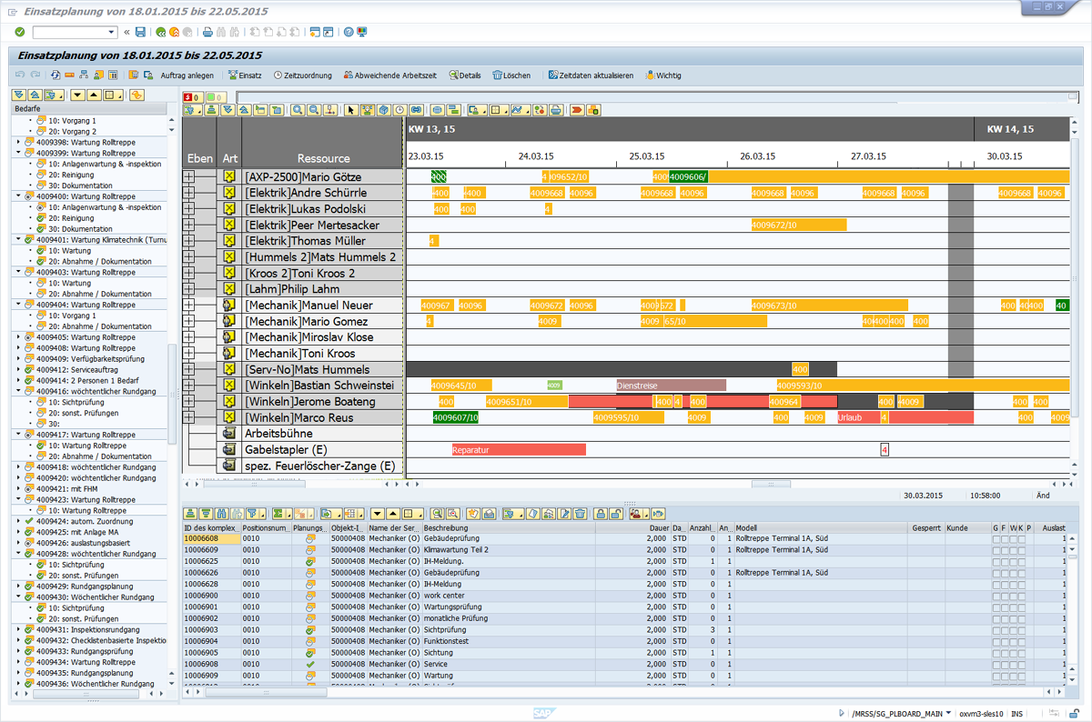
SAP MRS Planning Board in ERP
Planning Board
Order Demand (Worklist)
Resources
(Item worklist)
Status, Alert monitor
Notes:
MRS Planning Board:
-Resources (Available hours per week, Utilization), -Demand (Status of operations and activities, Number of resources required),
-Features(Easy to use, Drag and drop, All the tools, equipment, time allocations and people in a single screen, General dashboard of the availability and utilization of the resources, Flexible scheduling:[Absences, Illness, Multiple resources assigned to an operation, Split of assignments], Effective allocation of special qualifications)

Slide 21
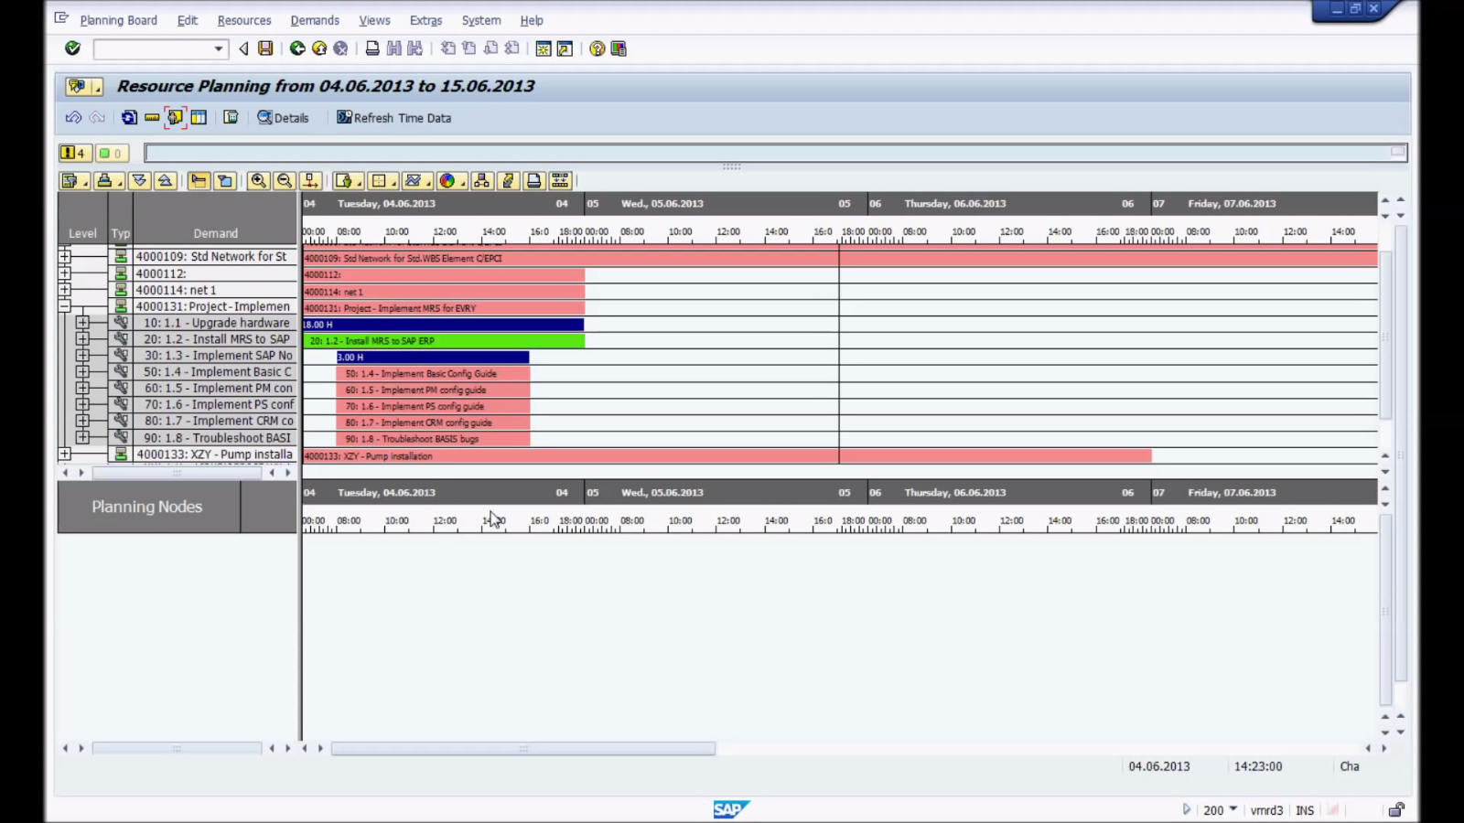
Demand Planning board
Notes:
Demand Planning board
- Different colors
o Untouched
o Finished
o Started

Slide 22
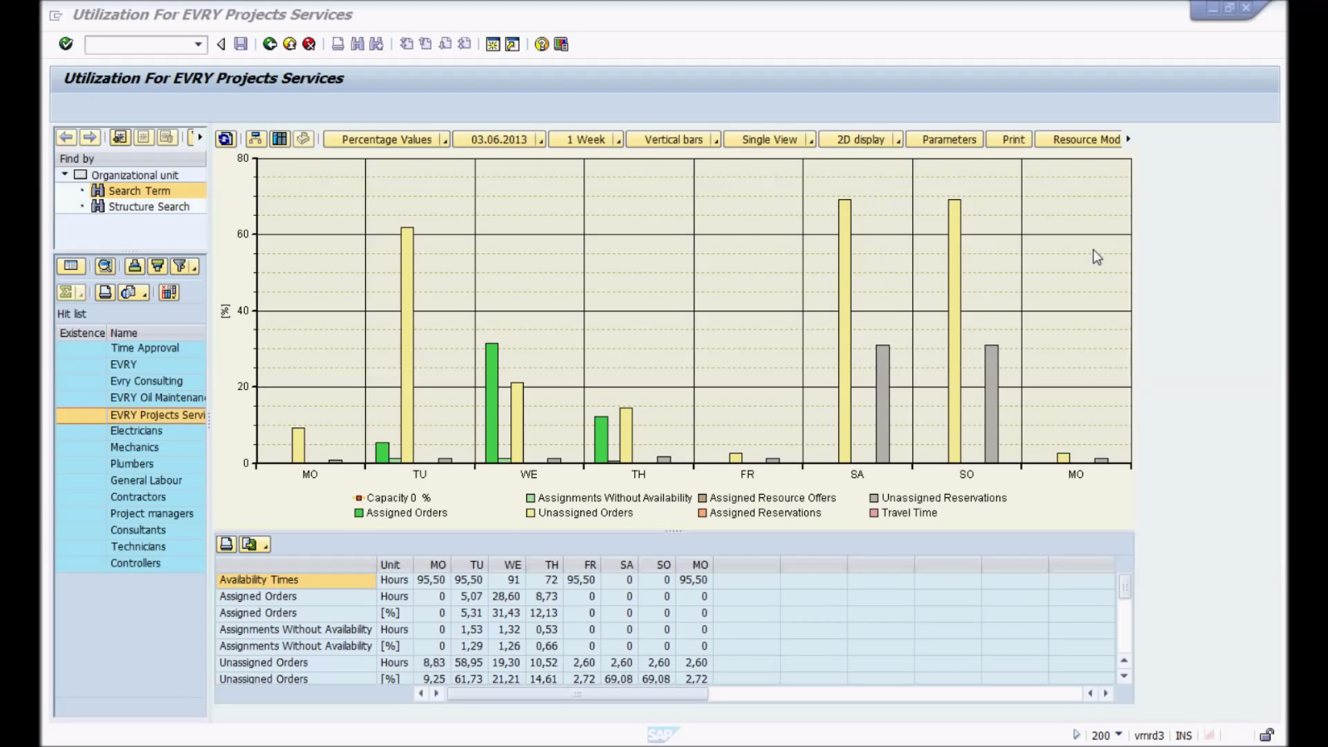
Utilization report
Notes:
Utilization report
- Select your group
o Assigned orders
o Work to be done
o Reports

Slide 23

Persona: Albert
Role: Maintenance Shift Supervisor
Responsibilities:
Control Maintenance Performed by Shift
Control Participation of Shift Personnel in Non-maintenance activities
Report Maintenance Labor Capacity
Frustrations:
Heavily reliance on whiteboards and post-it’s
Lack of user context in existing user interfaces
Complex navigation
Notes:
CHALLENGE 4
Challenge 4 pertains to bad user experience.
In solving user experience problems, we begin by knowing our persona.
Gary is a maintenance shift supervisor and his major responsibilities are:
a.) To control the maintenance performed by his shift
b.) Oversee participation of shift personnel in non-maintenance activities
c.) Report maintenance labor capacity to the planner
Along the way, he encounters several frustrations such as:
a.) Heavy reliance on whiteboards and post-it’s which are crude forms of documentation and may result in inaccuracies and inconsistencies
b.) Existing user interfaces does not have context: these does not provide him the very information that he needs
c.) Complex navigation structures not only working his way through the system cumbersome but adds overhead time in accomplishing his job

Slide 24
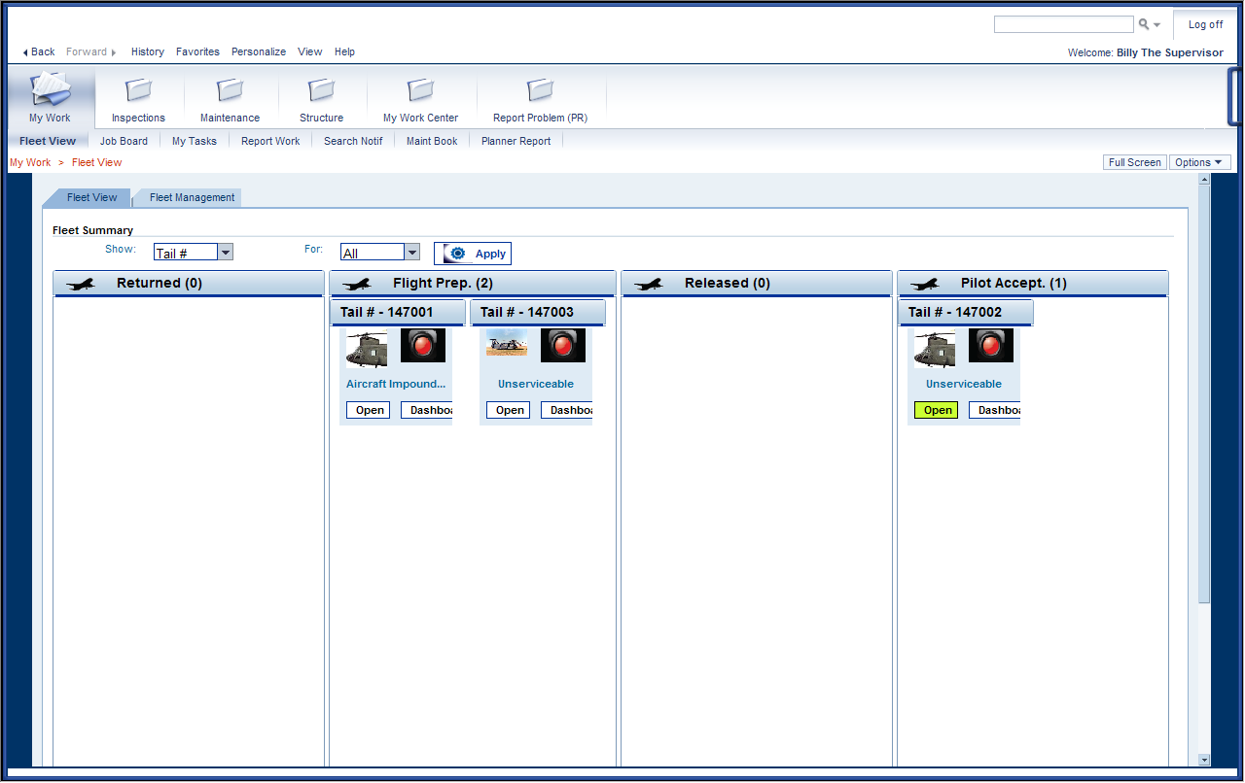
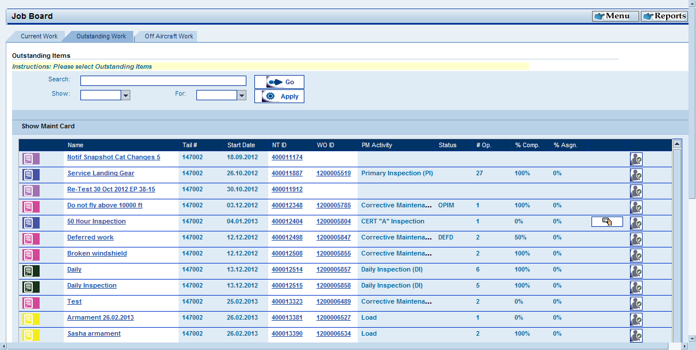
Challenge 4: Bad User Experience for Shift Supervisors
Maintainer’s Portal Contextually-unaware interface
Complex Navigation Drill-down style interfaces
Notes:
These are two major UX pain points: contextually-unaware interfaces from the Maintainer’s Portal and drill-down, complex style navigation

Slide 25

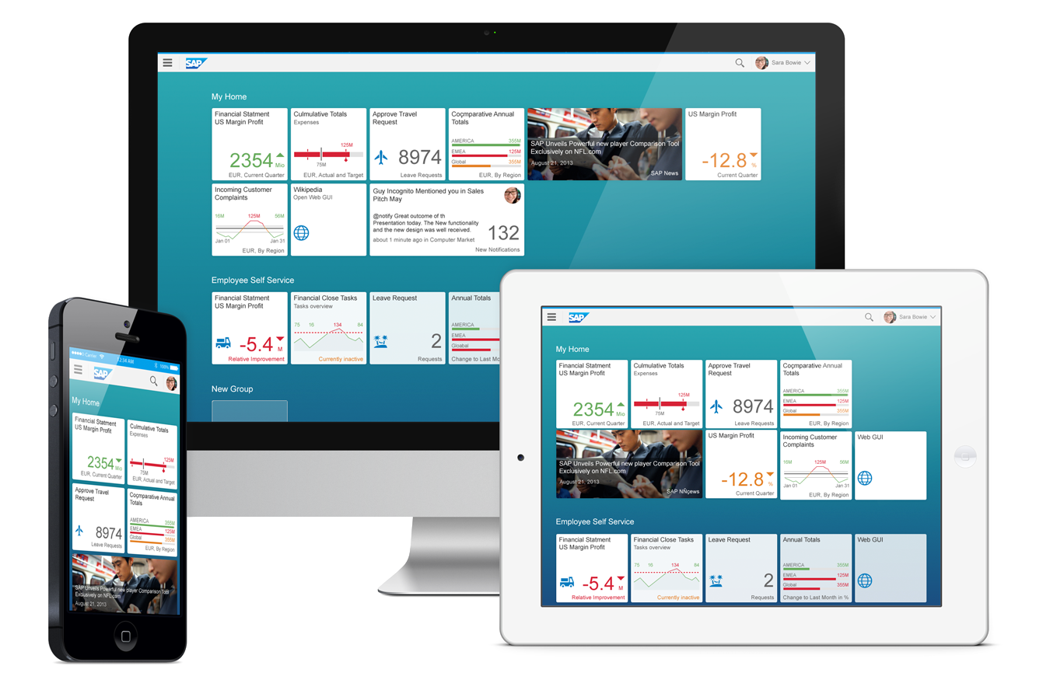

Better
User Experiences
with
Notes:
The answer: SAP Fiori. Fiori embodies mobile-first, consumer-grade productivity applications for common enterprise scenarios.

Slide 26
What is SAP Fiori?
Humanized
Humanized
Natural language
Context-aware
Adaptive
Applications available across a variety of devices
Activity-based
Applications based on business functions
Simple
Personalized interfaces provides only what the user needs
Coherent
Interfaces provide a fluid, intuitive and streamlined experience
Delightful
Provide a
Worthwhile user experience!
Notes:
It provides a more human look and feel, adaptive as it can work across a variety of devices, activity-based which focuses on one major task or function, simple – only providing what is essential, coherent – consistent and fluid experience. All of these work towards providing a delightful user experience.

Slide 27
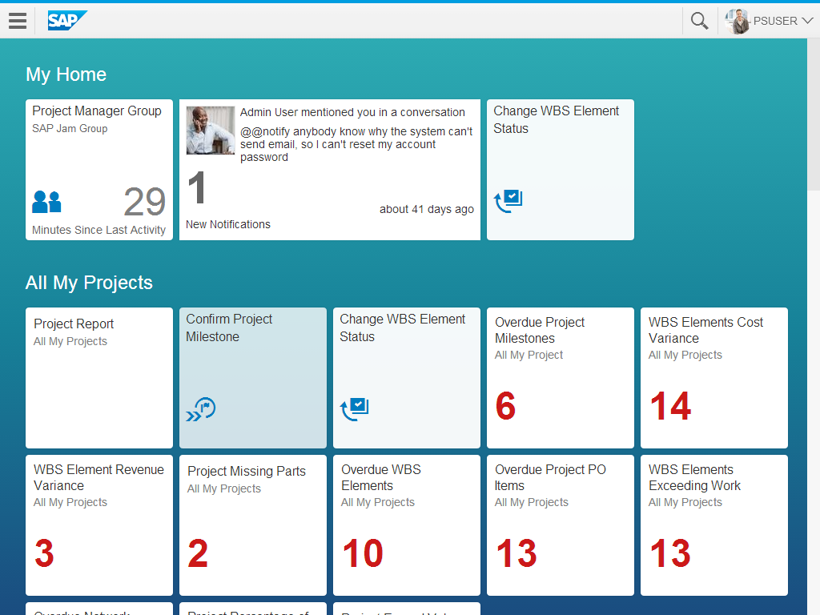
Anatomy of an App
UI Component: SAP UI5
Integration Component:
Netweaver Gateway (OData Service)
Notes:
Every Fiori app consists of two components: the presentation or UI component through SAP UI5 and the integration component through Netweaver Gateway and OData services.

Slide 28
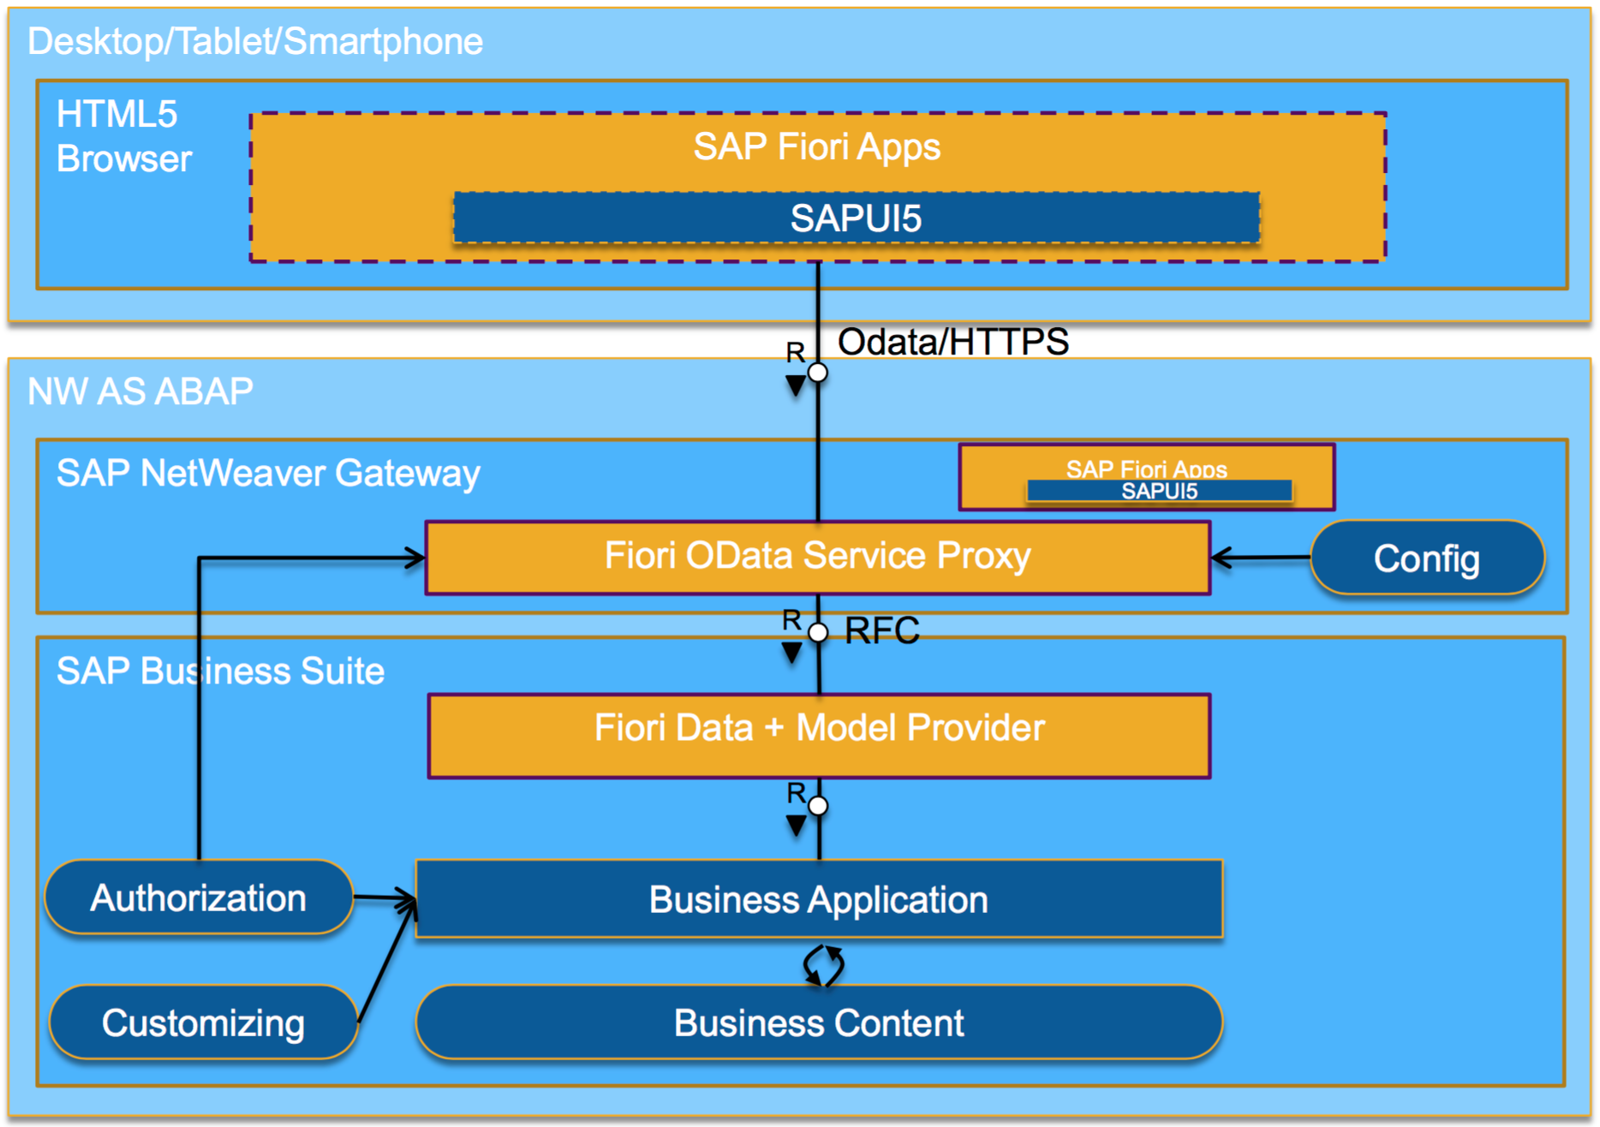
SAP Fiori UI5 Architecture (Simplified)
Custom UI5 ‘Fiori-like’ App
Notes:
This is a simplified SAP UI5 architecture where you can see Fiori Apps are based from SAP UI5 and the interaction with the app to the NetWeaver Gateway through OData services.
Our solutions approach is to leverage existing Fiori / SAP UI5 technologies to design and build custom applications that are geared towards fulfilling the needs of the maintenance shift supervisor.

Slide 29
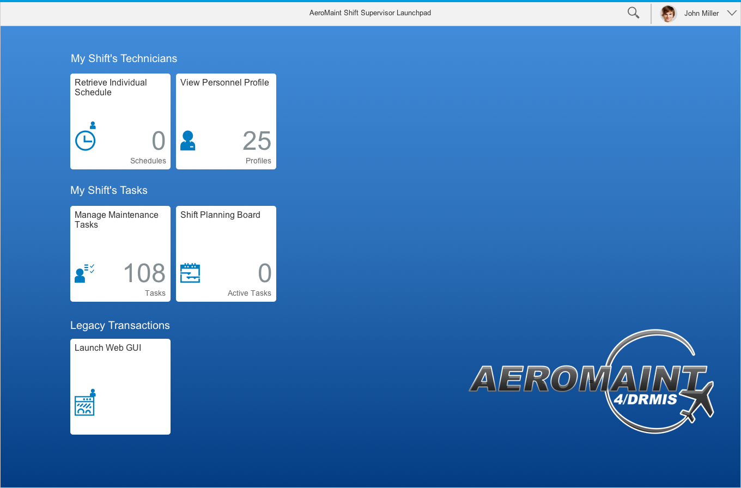
AeroMaint 4/DRMIS Shift Supervisor Launchpad
Notes:
Our SAPUI5 application will aptly be called AEROMAINT 4/DRMIS (Defense Resource Management Information System)
Launchpad:
The Launchpad acts as the single point of entry for all applications. We have four applications for the Shift Supervisor which I will discuss them one by one.

Slide 30
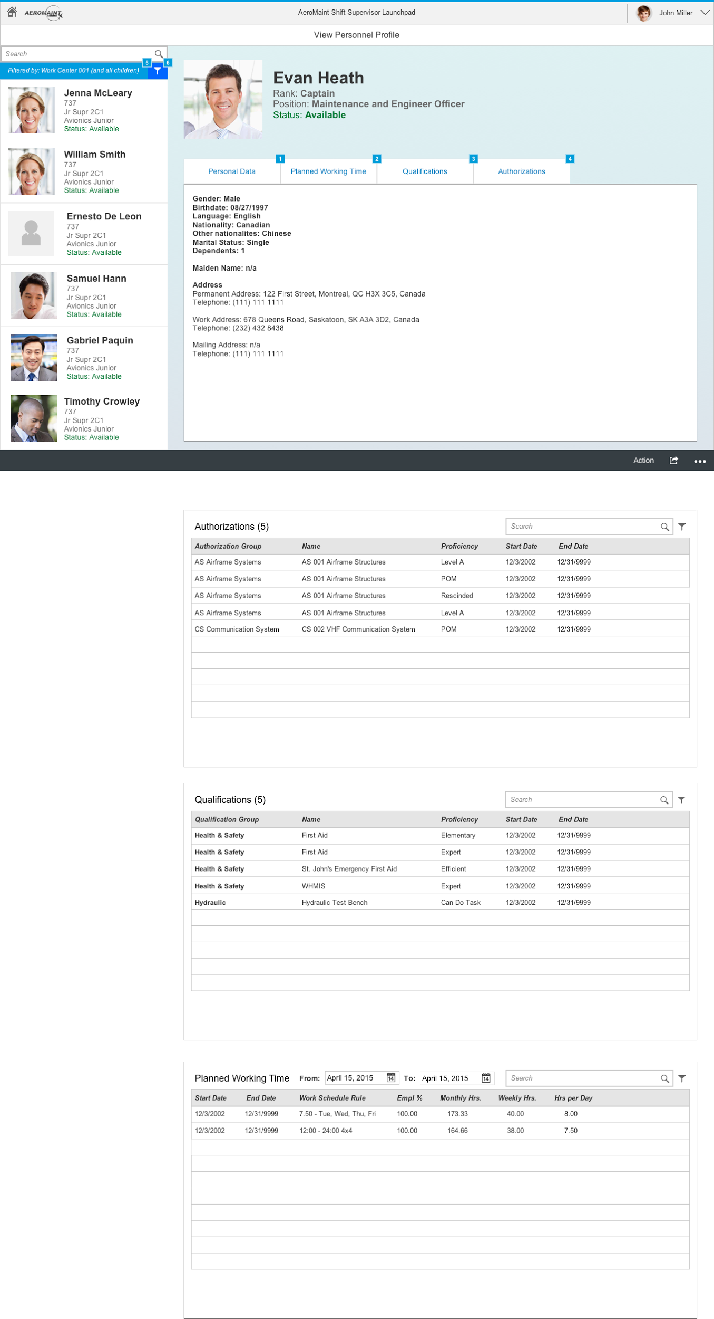
AeroMaint 4/DRMIS View Personnel Profile
Notes:
View Personnel Profile
The View Personnel Profile is designed as a one stop viewpoint for personnel’s salient information as required for the shift supervisor’s decision making
Personnel information include:
- Personal Data – for basic information
- Planned Working Time – for the work schedule
- Qualifications – for skills, trainings, certifications
- Authorizations – for granted permissions to use those
acquired skills
Personnel can be filtered by name and parent and child work centers
And this sidebar is uniform across all applications.

Slide 31
AeroMaint 4/DRMIS Shift Supervisor Launchpad

Slide 32
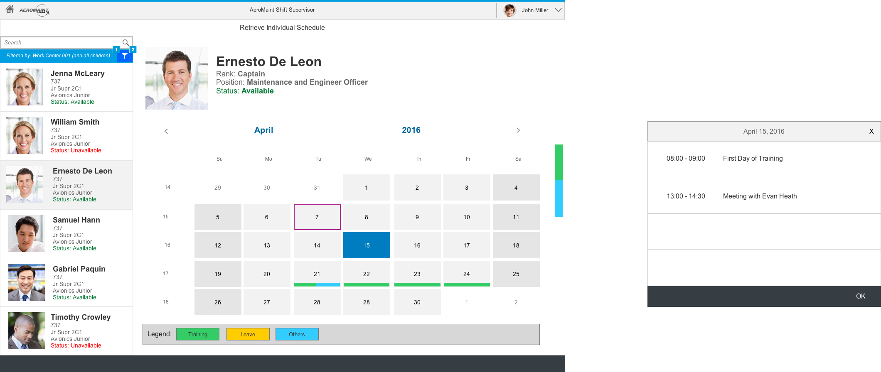
AeroMaint 4/DRMIS Retrieve Individual Schedule
Notes:
Retrieve Individual Schedule
The Retrieve Individual Schedule app provides a calendar view of the personnel’s availability as indicated by three label types: training, leave and others
This app is useful for planning schedules and operations ahead of time.

Slide 33
AeroMaint 4/DRMIS Shift Supervisor Launchpad

Slide 34
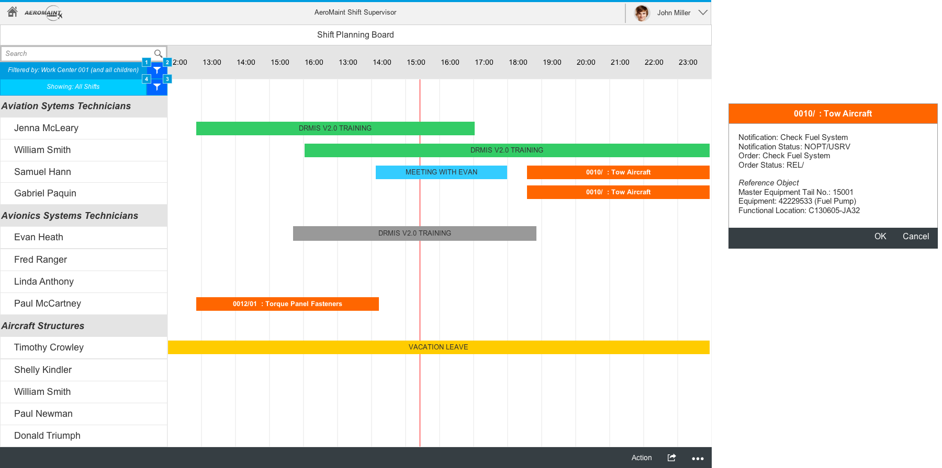
AeroMaint 4/DRMIS Shift Planning Board
Notes:
Shift Planning Board
This app is designed for planning the shift activities. Personnel, their operations and availabilities are represented in timeline view.

Slide 35
AeroMaint 4/DRMIS Shift Supervisor Launchpad

Slide 36
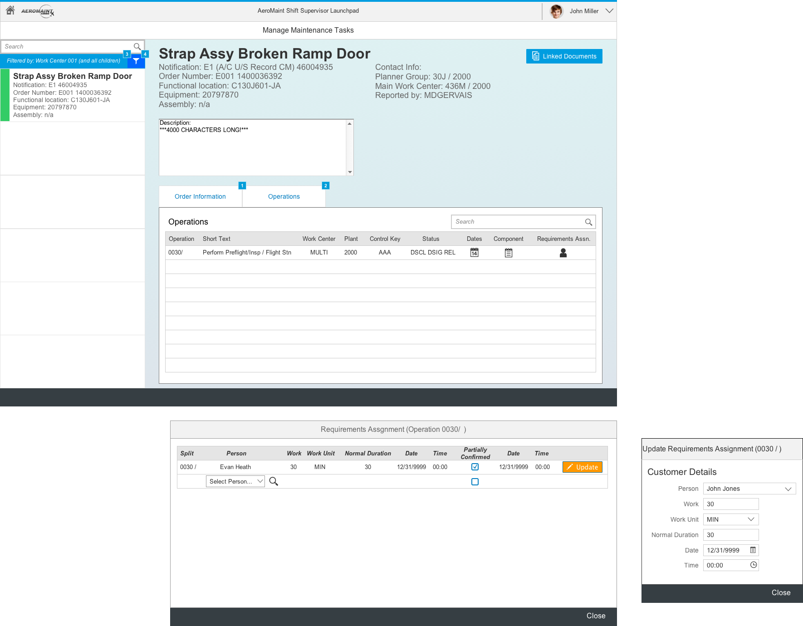
AeroMaint 4/DRMIS Manage Maintenance Tasks
Notes:
Manage Maintenance Tasks
Tasks are shown and filtered by parent and child work centers and this app enables the shift supervisor to assign tasks and associated time elements such as expected work duration.

Slide 37
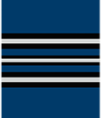
Persona: Gary
Role: Maintenance Manager
Responsibilities:
Control all maintenance at a squadron:
15~20 aircraft
250~300 technicians, supervisors, planners, etc.
Supply aircraft to Operations group for missions
Frustrations:
Information he needs is scattered across several traditional SAP ERP modules:
Flight Orders
Maintenance Notifications / Orders
Maintenance Order Capacity Requirements
Work Center / Capacities Available
Notes:
CHALLENGE 5
Challenge 5 is related to bad user experience but is more focused on reporting. To get a better picture, we will have Gary who is our maintenance manager. He is responsible for controlling all maintenance activities in his squadron and ensure aircraft needed by operations is being met.

Slide 38

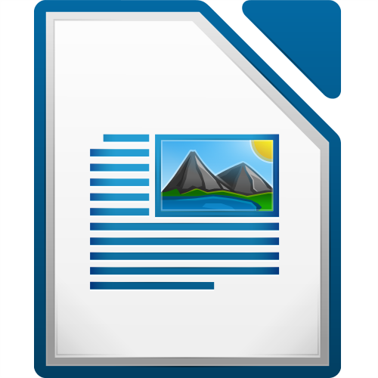
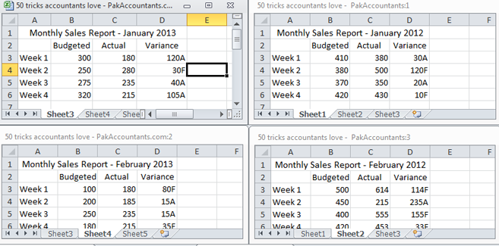



Challenge 5: Lack of single point of data aggregation
Scattered Information To get an overview of the current situation in the entire organization
Convergence of Information Simultaneous display of aircraft demand and supply through flight and maintenance orders.
i
Notes:
In order to accomplish this, Gary needs to get an overview of the aircraft states to understand the projected demand and capacity at any given time. Currently however, he consults multiple systems and different screens, thus having SCATTERED INFORMATION.
Our solutions approach is to ensure the information he needs is CONVERGED, to make decision making and analysis easier and more intuitive.

Slide 39
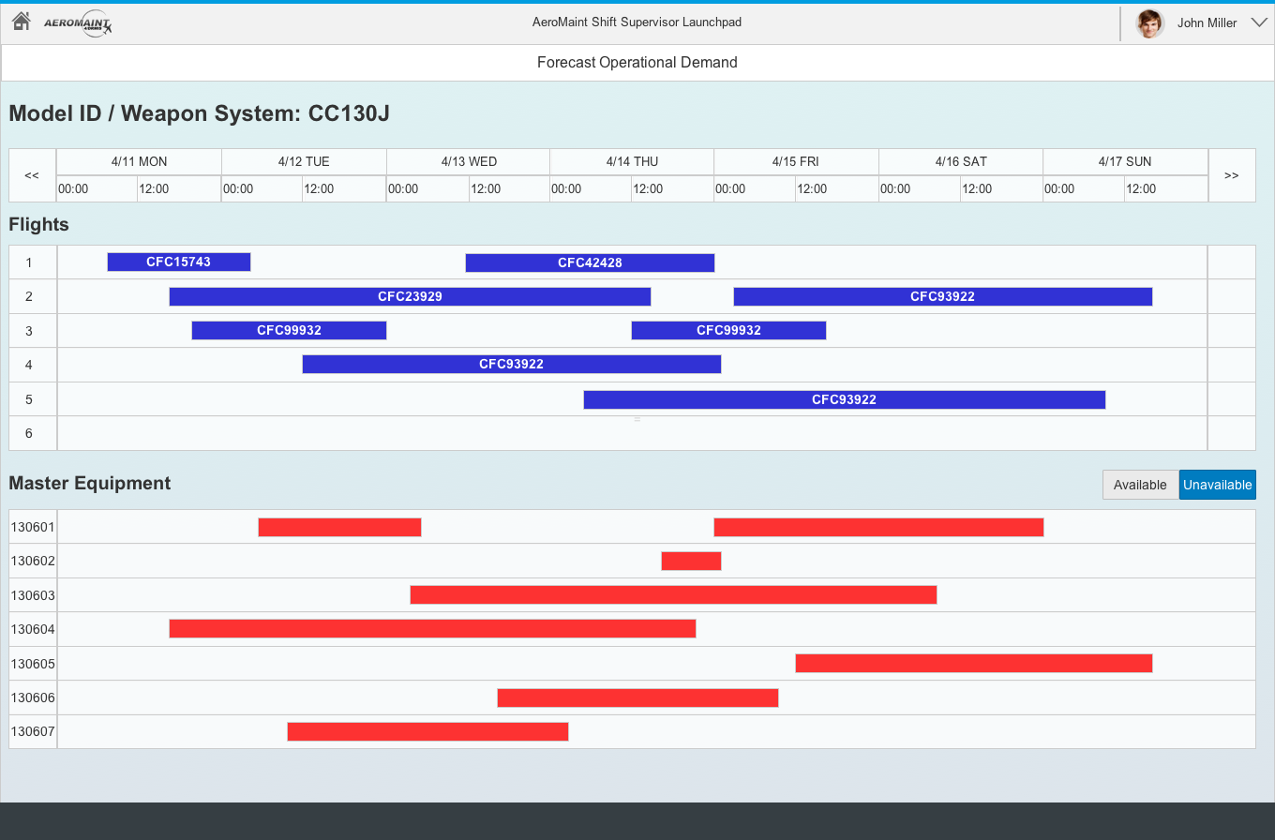
AeroMaint 4/DRMIS Forecast Operational Demand
Notes:
Forecast Operational Demand
In this instance, an asset group, CC130J is shown across a timeline with corresponding flight operations together with the master equipment and when you drill down for more information, this will redirect to…

Slide 40
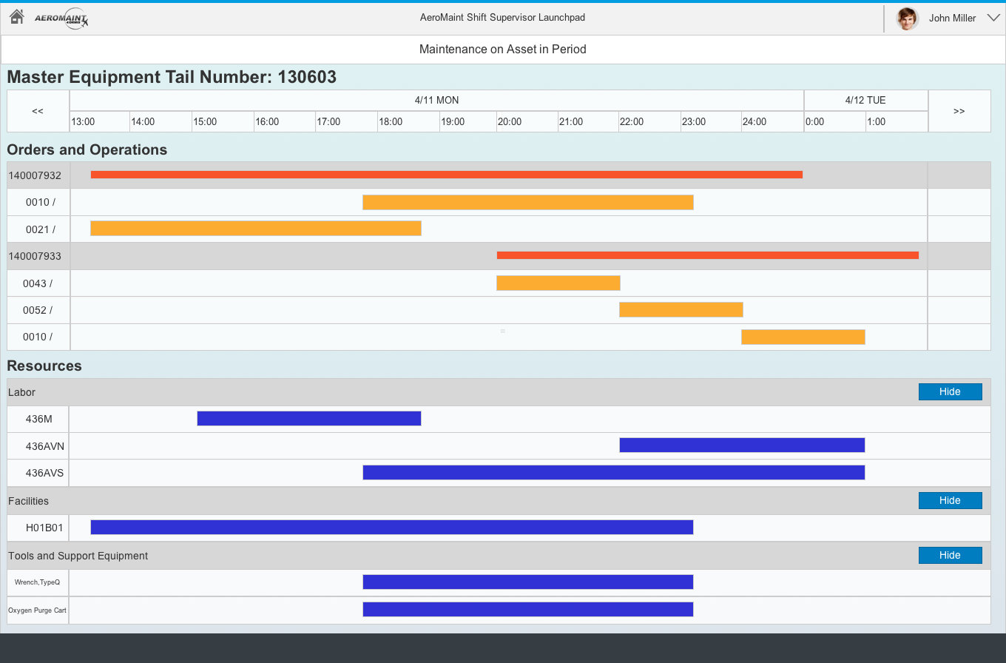
AeroMaint 4/DRMIS Maintenance on Asset in Period
Notes:
Maintenance on Asset in Period
This app provides a more detailed view of the master equipment in the previous screen. This shows the orders and operations and the resources needed to fulfill the operation, that is: labor, facilities and tools or support equipment. Colored bars reflect the availability of these resources.
I will now give the floor back to Evan for the conclusion.

Slide 41
Conclusion
 | Challenge: | As-Is
 | Lack of Demand Data | Planning in Separate Systems with details sent in Office Docs
 | Annual Estimates | Arduous process to update individual measurement points
 | Weekly Forecasts | Cumbersome to plan using SAP ERP, done offline instead
 | Bad User Experience | Shift Supervisors lacks direct way to execute their activities
 | Data Aggregation | Maintenance Managers can’t bring together necessary info
Notes:
Identifying both the missions and aircraft allocated to missions within SAP ERP, in real time and with a single version of the truth will help manage aircraft availability and minimize cancellations.

Slide 42
Conclusion
 | Challenge: | To-Be
 | Lack of Demand Data | Flight Order convey mission details to Maintenance and allot aircraft to flights.
 | Annual Estimates | Values maintained only for master equipment - automation distributes these down complete technical structure
 | Weekly Forecasts | SAP MRS provides planning interface for interacting with necessary information
 | Bad User Experience | Shift Supervisors’ interfaces simplified to deliver ready access to functionality they need
 | Data Aggregation | Maintenance Managers see Flights, Aircraft, maintenance periods in one spot
Notes:
Identifying both the missions and aircraft allocated to missions within SAP ERP, in real time and with a single version of the truth will help manage aircraft availability and minimize cancellations.

Slide 43

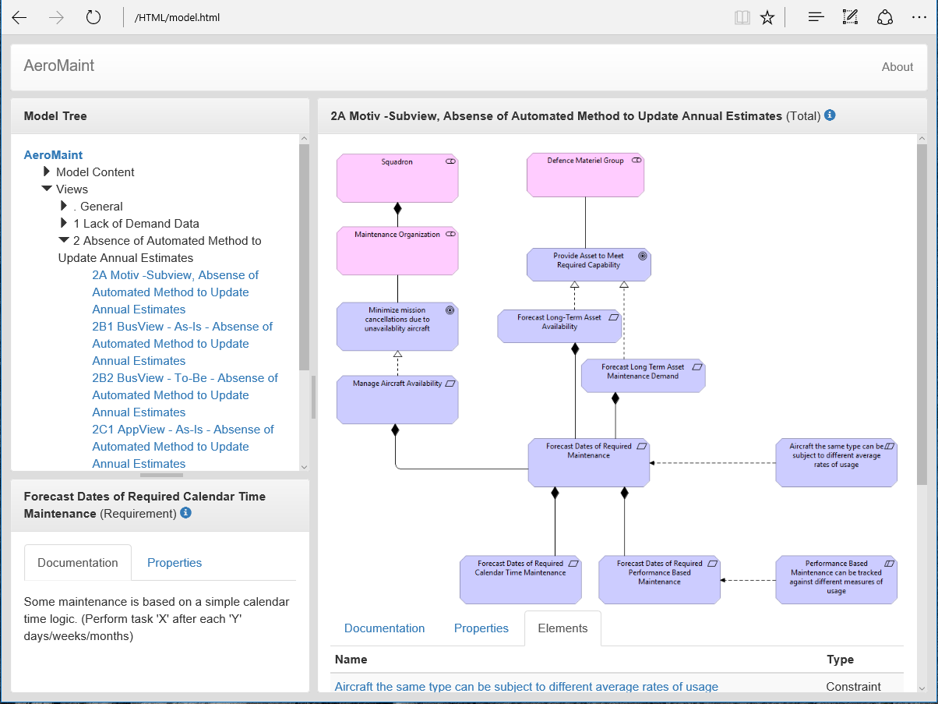
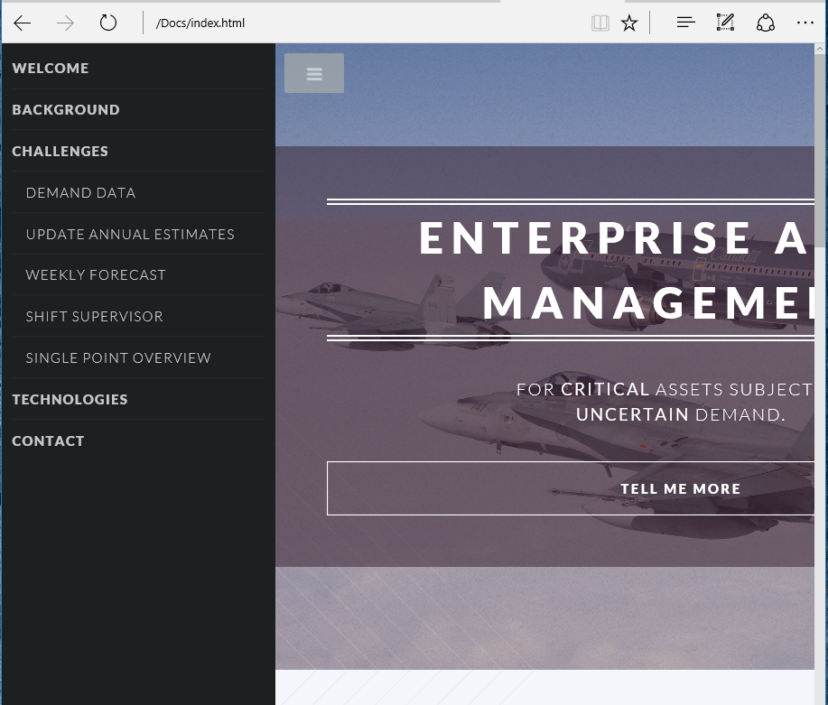
The Deliverables
Model Export Delivered in HTML Viewable in browser
Additional Documents Delivered in HTML Viewable in browser Hyperlink to model diagrams
Click here

Slide 44
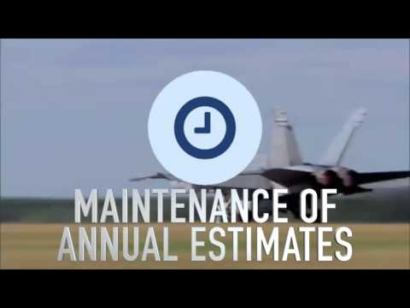

Slide 45
Enterprise Asset Management
for Critical Assets subject to
Uncertain Demand
Questions?
Norence Tan | Evan Heath | Ernesto Aguilar | Wilfredo Aleman
Click here
Notes:
EAM - This is the latest term SAP uses for Capital Asset Management / Plant Maintenance
Critical Assets are those whose unavailability would have major impacts to your business
Uncertain Demand the asset is used to produce goods, or deliver services and this demand itself is only predictable to a limited extent

Slide 46
Challenge 2: Absence of Automated Method to Update annual estimates
As-Is: In SAP ECC, an aircraft is represented as a hierarchical structure of hundreds of Functional Locations and Equipment each of which may have many measurement points against which usage data is accrued. Maintenance Plans for Preventive Tasks reference annual estimates values of these measurement points in order to forecast due dates for preventive tasks. Thousands of separate measurement point annual estimates are not updated to reflect real-life utilization rates.
Gap Identified: Forecast dates for Preventive Tasks are inaccurate due to unrealistic measurement point annual estimates.
To-Be: Custom transaction and tables to be developed to maintain aircraft specific usage rates per period. Custom transaction to apply the correct usage rate to an entire aircraft’s technical structure hierarchy en-mass to be developed.

Slide 47
Overview: Performance Based Preventive Maintenance in SAP ECC
Where does the data come from? (Equipment and Functional Location Measurement Points, Measurement Documents, Annual Estimates, Maintenance Plans)
How does the algorithm work (include graphic).
Demonstrate how inaccurate annual estimates throw off date forecasts for future tasks.

Slide 48
An aircraft is a hierarchy of functional locations and equipment
Aircraft 0001 [FLoc]
3004369 Aircraft 0001 [MasterEquip]
A001PE1 Engine 1 [FLoc]
A001S Structure [FLoc]
A001PE1CT Controls [FLoc]
A001SFF Fwd Fuselage [FLoc]
A001PE1CF FADEC [FLoc]
A001SMF Mid Fuselage [FLoc]
3008976 FADEC [Equip]
A001P Propulsion [FLoc]
A001PE1C Compressor [FLoc]
A001PE1 Engine 1 [FLoc]
A001PE1CD1 Disk 1 [FLoc]
3007896 Disk, Compressor [Equip]
A001PE2 Engine 2 [FLoc]
A001PE1CD2 Disk 2 [FLoc]
A001H Hydraulics [FLoc]
3007897 Disk, Compressor [Equip]
A001HM Main [FLoc]
A001PE1CD3 Disk 3 [FLoc]
3007898 Disk, Compressor [Equip]
A001HR Reserve [FLoc]
Notes:
A single aircraft is comprised of a structure of hundreds of Functional Locations (FLocs) and Equipment assembled in a hierarchy and related to a single ‘Master’ Equipment.
Equipment is installed in a functional location. The entire hierarchy below it forms an equipment
FADEC = Full Authority Digital Engine Control

Slide 49
How does performance-based maintenance work?
Aircraft 0001 [FLoc]
3004369 Aircraft 0001 [MasterEquip]
3007896 Disk, Compressor [Equip]
752387 Engine Hours [MeasPt]
8700007665
5,897 Hours [Measurement Document]
9007456
“Remove Compressor Disk ‘7896 for Overhaul” [Maintenance Item]
5004587
“Overhaul Compressor Disk Each 10,000 Operating Hours” [Maintenance Plan]
A/1005/05 Remove Compressor Disk for Overhaul [PM Task List]
Aspects to consider:
Annual estimates strongly depend on availability of aircraft demand data (challenge 1)
Accuracy of forecasted dates can be improved focusing attention on a small set of Measuring Points updated in multiple places
Notes:
To schedule maintenance on an aircraft, the specific maintenance tasks need to be related to the particular components (parts) as they may not have the same degree of usage as the aircraft in which they are installed. Engines, engine internal components, pumps, etc. can all be removed and re-installed in the course of maintenance and it is guaranteed that not all components will remain with the same parent aircraft through their entire life. Every individual instance of a scheduled task for a particular serial number of an item requires a maintenance item and maintenance plan. For scheduled maintenance that is related to performance, the maintenance plan references a measurement point on the subject item. To forecast the due date of the maintenance task, the ‘Annual Estimate’ property of the measurement point is used in an algorithm along with the last measurement reading, last reading date, and last task execution date to forecast when the maintenance will take place.
With thousands of equipment, there are therefore thousands of measurement points. In the standard SAP ECC, it is necessary to maintain Measurement Point master data one-by-one.
But, even though there are thousands of measurement points, they are all within the hiearchies of a limited number of aircraft and within a particular aircraft, all equipment is utilized at the same rate.

